Slide 1
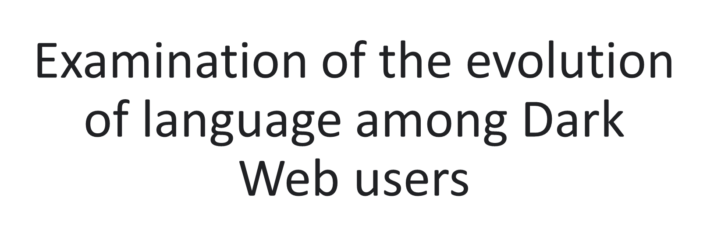


Mentor: Andrea Underhill, Jane Daquin

Slide 2
Project Objective
Identify relevant topics in user conversations on the Dark Web;
Study the evolution of these topics over time;
Techniques used: NLP, Machine Learning

Slide 3
Why This Work is Important
Insights: Helps understand criminal activities and how their language changes, useful for police and researchers.
Unique Approach: Looks at a large dataset from one forum, with plans to include more forums for a fuller picture.
Future Potential: Could include data from other sources and images for better results.

Slide 4
Methodology
Dataset: About 300k conversations from the Dread forum
Tool: BERTopic library
Algorithm: SBERT to transform text into vectors
Additional Technique: C-TFIDF for topic representation
Process: Dimensionality reduction and clustering
Topic Naming: Zero-shot classification/GenAI to assign topic names

Slide 5
Findings: Main Topics
Baselines: 7, 68, and 121 topics
Examples:
Drug sales
Password sales
Hacking
Drug markets
Vendor reviews
Bitcoin
Fraud
PGP key
Opsec questions
Closed markets

Slide 6
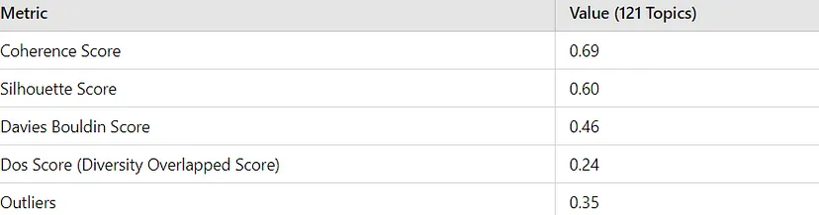
Validating Topics: Clustering Metrics

Slide 7
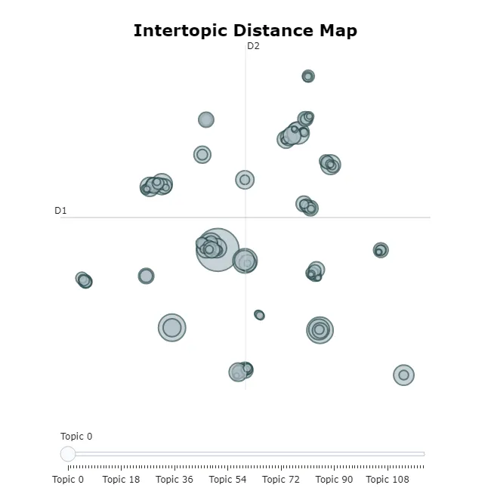
Validating Topics: Graphs

Slide 8
Findings: Evolution Over Time
Analysis: Keyword changes over time for each topic
Tools: BERTopic module, LSTM
Visualization: Time series plots of topic distribution

Slide 9
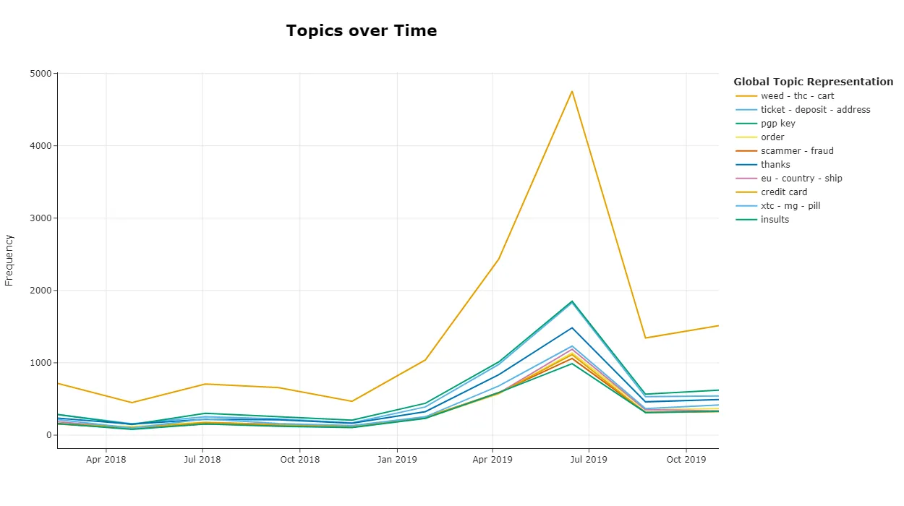
Topic Distribution Over Time
Topic 9: 2019: (pill, mg, pharma, price, xtc) | 2020: (mg, pill, price, xtc, mdma)

Slide 10
Next Steps
Validate discovered topics
Validate evolution over time with LSTM
Integrate generative AI to explain labels
Push models to Hugging Face
Potential: Make the model multimodal with images

Slide 11
Thank You!

